Slide 1

QUARTERLY BUSINESS REVIEW
Q3 2024
Financial Performance Report
Third Quarter 2024
Performance Summary
$47.3M
+12%
Confidential • Internal Use Only
Total Revenue
YoY Growth

Slide 2
OVERVIEW
Executive Overview
Comprehensive analysis of Q3 2024 performance across all business dimensions
01
Financial Highlights
02
Revenue Performance
Key performance metrics, revenue growth, and profitability improvements
Growth trajectory and market expansion achievements
03
Operating Efficiency
04
Segment Analysis
Margin improvements and cost optimization initiatives
Regional performance breakdown and growth drivers
05
Operational Achievements
06
Strategic Initiatives
Customer metrics, product development, and excellence initiatives
Sustainability, diversity, and acquisition progress
07
Outlook & Guidance
08
Risk Assessment
Q4 projections and full-year expectations
Key risks and mitigation strategies

Slide 3
SECTION 01
Q3 2024 Financial Highlights
Strong performance across all key metrics demonstrating strategic execution
+12% YoY
+2.4pp QoQ
18-Month High
$47.3M
18.2%
14.3%
Total Revenue
Operating Margin
Return on Invested Capital
Driven by strong market demand and successful expansion
Improved from 15.8% in Q2 through efficiency gains
Signaling improved capital efficiency across all units
Operating Expenses Breakdown
Key Performance Indicators
Cost of Goods Sold
-3.2%
Production Volume
+7%
Decreased despite 7% production volume increase
G&A Expenses
$4.1M
Manufacturing Efficiency
Improved
Held flat through productivity initiatives
Sales & Marketing
$8.9M (+5%)
Supply Chain Optimization
Enhanced
Investment in 3 new geographic markets
Automation ROI
Positive

Slide 4
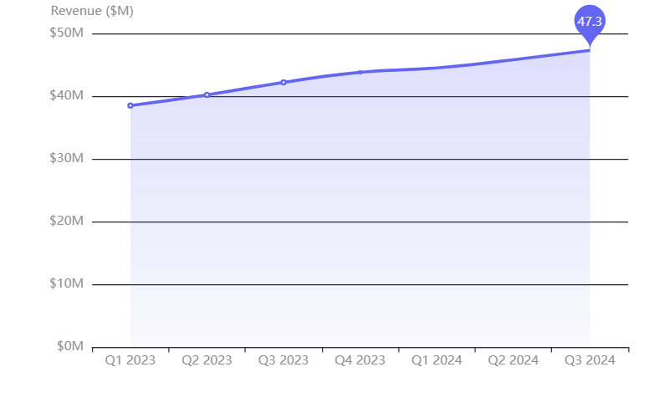
SECTION 02
Revenue Performance & Growth Trajectory
Sustained growth driven by market expansion and product demand
Quarterly Revenue Trend
Growth Drivers
Core Product Demand
Strong market demand across all product lines
Southeast Asia Expansion
Successful market entry and penetration
Eastern Europe Growth
Strategic expansion yielding results
Revenue Composition
Product Sales
78%
Services
15%
Licensing
7%

Slide 5
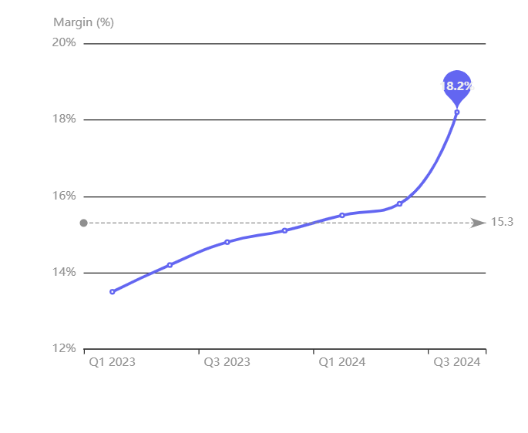
SECTION 03
Operating Margin & Cost Efficiency
Significant margin expansion through operational excellence
Operating Margin Trend
Cost of Goods Sold
-3.2%
+7%
-3.2%
Production Volume
COGS
Demonstrating effectiveness of automation investments and manufacturing efficiencies
Efficiency Drivers
Automation Investments
Manufacturing process optimization
Supply Chain Optimization
Improved logistics and procurement
Workforce Productivity
Enhanced operational efficiency
15.8% → 18.2%
$4.1M
$8.9M
Operating Margin Improvement
G&A Expenses (Flat QoQ)
Sales & Marketing (+5%)

Slide 6
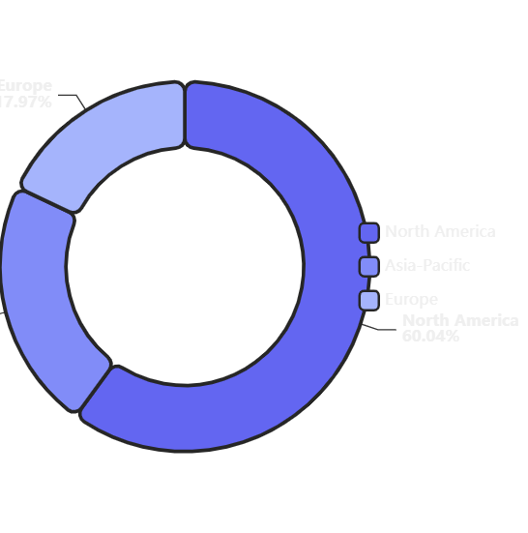
SECTION 04
Segment Performance Overview
Revenue distribution and growth across key geographic markets
Revenue by Region
North America
$28.4M
Largest market by revenue
60% of total
+10%
94%
YoY Growth
Client Retention
Asia-Pacific
$10.4M
Highest growth rate
22% of total
+28%
Partnerships
YoY Growth
Regional distributors
Europe
$8.5M
Steady performance
18% of total
+8%
+15%
YoY Growth
Benelux Share

Slide 7
SECTION 04 CONTINUED
Regional Deep Dive: Growth Drivers
Detailed analysis of performance factors across all markets
North America
Asia-Pacific
Europe
$28.4M Revenue
$10.4M Revenue
$8.5M Revenue
Enterprise Retention
Exceptional Growth
Steady Performance
94%
+28%
+8%
Sustained high client retention rates demonstrating strong value proposition and customer satisfaction
Highest growth rate driven by strategic partnerships with regional distributors and market expansion
Consistent growth despite economic headwinds in key markets
New Customer Growth
Partnership Success
Market Share Gains
+23%
Regional Distributors
+15%
Strong acquisition momentum through enhanced sales capabilities and market positioning
Successful collaboration with local partners enabling rapid market penetration
Significant market share increase in Benelux region through targeted strategies
Product Localization
Economic Context
Customized Solutions
Headwinds Managed
Tailored product offerings meeting regional market requirements
Navigating challenging macroeconomic environment effectively
Market leadership position maintained
Fastest growing region with strong momentum
Resilient performance in challenging market

Slide 8
SECTION 05
Operational Excellence & Customer Metrics
Improved efficiency and customer satisfaction driving sustainable growth
Customer Metrics
Key Operational Achievements
-12%
$340K
Campaign Targeting
Improved conversion optimization and marketing efficiency
Customer Acquisition Cost
Customer Lifetime Value
Improved targeting
Per enterprise client
Customer Retention
Enhanced retention through improved service delivery
Monthly Recurring Revenue
$15.8M
Cross-sell Opportunities
33% of total quarterly revenue providing predictability
Increased product adoption across customer base
Agile Implementation
Faster time-to-market for competitive features
Product Development Excellence
Development Cycle Reduction
Product Innovation
-25%
New Features Launched
2
Net Promoter Score
42 → 51
+9 points
Customer Feedback Integration
Aligned

Slide 9
SECTION 06
Strategic Initiatives & Sustainability
Measurable progress on ESG commitments and strategic growth
Sustainability Progress
Strategic Acquisitions
Carbon Emissions Reduction
-18%
3
Acquisitions Completed
Expanded intellectual property portfolio and added complementary service offerings
Facility emissions decreased through renewable energy procurement and operational efficiency programs
Integration Status
Proceeding ahead of schedule with strong operational alignment
Renewable Energy
Operational Efficiency
Synergy Timeline
Procurement increased
Programs implemented
Full operational synergies expected by Q2 2025
Diversity & Inclusion
Women in Engineering
37%
Strategic Impact
Up from 29% in Q3 2023
Women in Management
42%
IP Portfolio
Services
Strong leadership representation
Expanded
Enhanced

Slide 10
SECTION 07
Q4 2024 Outlook & Full-Year Guidance
Forward-looking projections and strategic priorities
Q4 2024 Projections
Capital Allocation Priorities
Technology Infrastructure
Revenue Growth (QoQ)
8-10%
Modernization of core systems and platforms
Constrained partly by seasonal effects but supported by strong enterprise sales pipeline
Manufacturing Capacity
Expansion in high-growth regions
Enterprise Pipeline
$16.2M
Strong sales pipeline providing visibility into Q4 performance
Margin Stabilization
Scale benefits offsetting inflationary pressures
Full-Year 2024 Guidance
Revenue Range
$185-190M
Approximately 11% annual growth
Investment Focus Areas
Capex
Op. Margin
Digital Infrastructure
High Priority
8%
18-19%
of revenue
stabilized
Geographic Expansion
High Priority

Slide 11
SECTION 08
Risk Factors & Mitigation Strategies
Proactive risk management ensuring business resilience
Macroeconomic Uncertainty
Risk Management Framework
1
Continuous Monitoring
Risk Description
Regular assessment of market conditions and supply chain health
Economic uncertainty in developed markets could impact enterprise spending decisions and investment cycles
2
Scenario Planning
Mitigation Strategies
Development of contingency plans for various risk scenarios
High Customer Retention: 94% retention rate provides revenue stability
3
Proactive Response
Diversified Footprint: Geographic diversification reduces concentration risk
Rapid deployment of mitigation measures when risks materialize
Supply Chain Vulnerabilities
Resilience Indicators
Risk Description
Semiconductor sourcing challenges and supply chain disruptions could impact production capacity
94%
3
Customer Retention
Geographic Regions
Mitigation Strategies
Dual-Sourcing: Multiple suppliers for critical components
90 Days
Dual
Inventory Buffers: 90-day buffers for high-demand items
Inventory Buffer
Sourcing Strategy

Slide 12

CONCLUSION
Positioned for
Continued Growth
Q3 2024 demonstrates that our strategic investments in market expansion, operational efficiency, and product innovation are yielding measurable returns.
With diversified revenue streams, improved profitability metrics, and strong cash generation, we remain focused on profitable expansion, customer satisfaction, and sustainable value creation.
$47.3M
+12%
18.2%
14.3%
Q3 Revenue
YoY Growth
Operating Margin
ROIC

