Slide 1


Biology • Educational Series
Cell Structure
and Function
A Comprehensive Guide to the Fundamental Unit of Life
NCERT-Style Content
High School Level
Scientific Illustration Series • Vol. I
2026

Slide 2
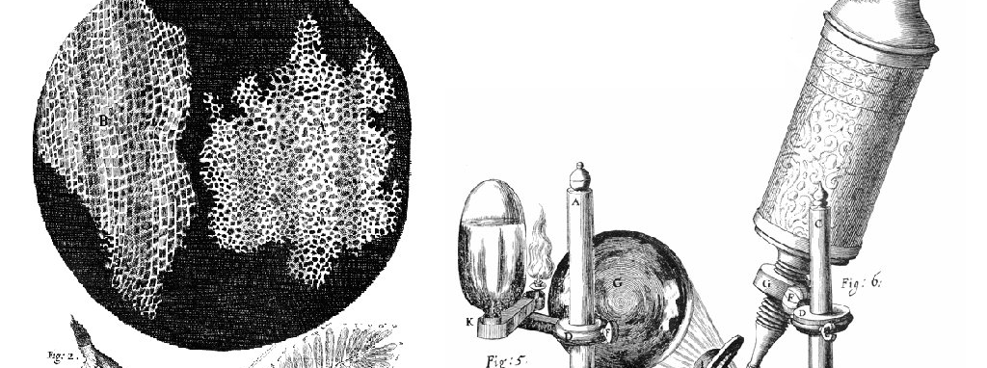
01
Foundation of Biology
Cell Theory
The Three Principles
1
All living things are composed of cells
From bacteria to blue whales, life is cellular
2
Cells are the basic unit of structure
Organization and function emerge from cellular architecture
3
All cells arise from pre-existing cells
Cell division perpetuates life across generations
Fig. 1 • Robert Hooke's Micrographia (1665)
Key Insight
The cell is the smallest unit of life capable of independent functioning—carrying out metabolism, responding to stimuli, and reproducing.
Historical Context
The word "cell" was coined by Robert Hooke in 1665 when examining cork tissue under an early microscope.
The honeycomb-like structures reminded him of monastery cells.

Slide 3
02
Cell Classification
Prokaryotic vs Eukaryotic Cells
Prokaryotic
Eukaryotic
"Before nucleus"
"True nucleus"
Size
Size
0.5–5.0 micrometers
10–100 micrometers
Nucleus
Nucleus
No membrane-bound nucleus
Distinct membrane-bound nucleus
Organelles
Organelles
Lack membrane-bound organelles
Various membrane-bound organelles
DNA Location
DNA Location
Free in cytoplasm (nucleoid)
Enclosed within nucleus
Examples: Bacteria, Archaea
Examples: Animals, Plants, Fungi, Protists
Evolutionary Note: Eukaryotic cells evolved from prokaryotic ancestors approximately 1.5–2 billion years ago , representing a major leap in cellular complexity.

Slide 4
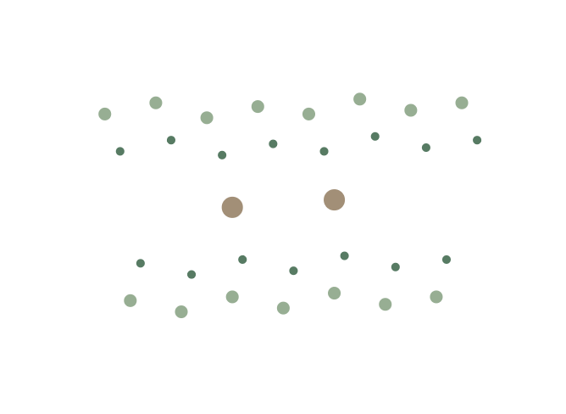
03
Cellular Boundary
The Cell Membrane
Fluid Mosaic Model
The membrane is a fluid structure with proteins embedded in or attached to a phospholipid bilayer, allowing dynamic movement and flexibility.
Phospholipid Bilayer Structure
Hydrophilic Heads
Water-loving, face outward
Hydrophobic Tails
Water-repelling, face inward
Membrane Proteins
Transport
Receptor
Facilitate movement
Bind signals
Recognition
Enzymatic
Identify "self"
Catalyze reactions
Fig. 2 • Fluid Mosaic Model Diagram
Function: The membrane is semi-permeable , regulating passage of substances between the cell's interior and external environment.

Slide 5
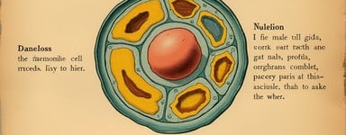
04
Control Center
The Nucleus
The Command Center
The nucleus is a membrane-bound organelle containing the cell's genetic material (DNA) and serving as the site of transcription and gene expression.
Key Functions
1
Genetic Storage
Houses DNA containing all genetic instructions
2
Transcription
Fig. 3 • Cell Organelles Diagram
DNA → RNA synthesis for protein production
3
Gene Expression
Regulates which genes are active/inactive
Did You Know?
The nucleus is surrounded by a double membrane called the nuclear envelope, perforated with nuclear pores that regulate molecular traffic.
The Nucleolus
Within the nucleus, the nucleolus synthesizes ribosomal RNA (rRNA) and assembles ribosomal subunits—essential for protein synthesis.

Slide 6
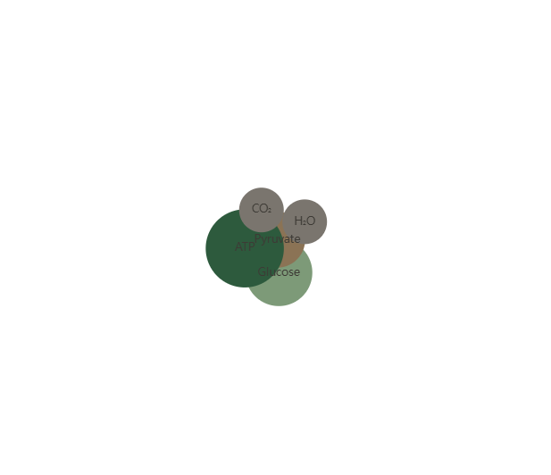
05
Energy Production
Mitochondria: The Powerhouse
Cellular Power Plant
Mitochondria are the sites of aerobic respiration , where glucose and other nutrients are oxidized to release energy in the form of ATP (adenosine triphosphate).
ATP Production Process
1
Glycolysis: Glucose breakdown in cytoplasm
2
Krebs Cycle: Energy extraction in matrix
3
Electron Transport: ATP synthesis in cristae
Endosymbiotic Theory
Mitochondria possess their own DNA and ribosomes , suggesting they evolved from free-living prokaryotes that formed symbiotic relationships with early eukaryotic cells.
~37
1000-2000
Trillion ATP molecules produced per cell daily
Mitochondria per typical animal cell

Slide 7
06
Manufacturing & Transport
Endomembrane System
Rough ER
Golgi Apparatus
Studded with ribosomes , giving it a "rough" appearance under microscopy.
Stack of flattened membrane-bound sacs called cisternae .
Primary Function:
Receives proteins from rough ER
Protein synthesis and initial protein folding
Modifies proteins (glycosylation)
Packages into vesicles for transport
Smooth ER
Protein Transport Pathway
Lacks ribosomes, appearing "smooth" with a tubular network structure.
Primary Functions:
Lipid synthesis, steroid hormone production, detoxification
Nucleus
Rough ER
Golgi
Vesicles

Slide 8
07
Cellular Components
Specialized Organelles
Lysosomes
Chloroplasts
Cytoskeleton
Membrane-bound organelles containing hydrolytic enzymes that break down cellular waste and foreign materials.
Plant-specific organelles where photosynthesis converts light energy into chemical energy (glucose).
Network of protein filaments providing structural support, enabling cell movement, and facilitating intracellular transport.
Functions:
Key Features:
Components:
• Digest worn-out organelles
• Double membrane structure
• Microfilaments: Cell shape, movement
• Break down food particles
• Internal thylakoid membranes
• Intermediate filaments: Structural support
• Destroy invading pathogens
• Chlorophyll pigments
• Microtubules: Organelle transport
• Apoptosis (programmed cell death)
• Own DNA (endosymbiotic origin)
• Flagella/Cilia: Cell locomotion
Cellular Harmony: These specialized organelles work in coordination—lysosomes recycle materials, chloroplasts (in plants) capture energy, and the cytoskeleton maintains structure and enables dynamic cellular processes.

Slide 9
08
Cellular Reproduction
Cell Division: Mitosis & Meiosis
Mitosis
Meiosis
Somatic (body) cells
Germ (sex) cells
Produces 2 identical daughter cells
Produces 4 non-identical cells
Maintains diploid chromosome number
Reduces to haploid chromosome number
Enables growth & tissue repair
Essential for sexual reproduction
Four Phases:
Genetic Variation Sources:
Prophase
Metaphase
Crossing Over
Chromosome condensation
Chromosome alignment
Exchange of genetic material between homologous chromosomes
Independent Assortment
Anaphase
Telophase
Random distribution of maternal/paternal chromosomes
Chromosome separation
Nuclear reformation
Comparison: Mitosis creates identical copies for growth, while meiosis generates genetic diversity essential for evolution and species adaptation.

Slide 10
09
Membrane Dynamics
Cellular Transport Mechanisms
Passive Transport
Active Transport
Requires no energy (ATP) —molecules move down their concentration gradient.
Requires energy (ATP) —moves substances against their concentration gradient.
Diffusion
Sodium-Potassium Pump
Movement from high → low concentration
The classic example of active transport:
Example: Oxygen entering cells, CO₂ exiting
Pumps 3 Na⁺ ions OUT of cell
Osmosis
Pumps 2 K⁺ ions INTO cell
Water movement across semi-permeable membrane
From low solute → high solute concentration
Biological Importance:
• Maintains ionic gradients essential for nerve impulses
• Enables muscle contraction and relaxation
Key Principle: Passive transport follows the laws of thermodynamics—systems naturally move toward equilibrium.
• Regulates cell volume and osmotic balance
Transport Comparison
Passive
Active
No ATP • Down gradient
Requires ATP • Against gradient

Slide 11
10
Real-World Impact
Significance & Modern Applications
Fundamental Understanding
Cutting-Edge Advances
Cell biology knowledge is essential for comprehending how organisms develop, maintain homeostasis, respond to environmental changes, and reproduce .
Immunotherapies
Harnessing the immune system to target cancer cells at the molecular level—revolutionizing cancer treatment.
Core Applications
CRISPR Gene Editing
Precise modification of DNA sequences to correct genetic defects and treat inherited diseases.
Medical Treatments
Regenerative Medicine
Understanding disease mechanisms at cellular level
Genetic Disease Research
Using stem cells to repair or replace damaged tissues and organs—offering hope for degenerative diseases.
Identifying cellular dysfunction causes
Biotechnology
Industrial and pharmaceutical applications
Future Horizons
"The cell is the basic unit of life, and understanding its structure and function is the foundation of all biological sciences."
Synthetic Biology
Personalized Medicine
— Modern Biology Principle
Tissue Engineering
Cellular Agriculture

Slide 12
The Living Cell
"Cells represent the intricate harmony of structure and function—the foundation upon which all life is built."
Discovery
Complexity
Diversity
1665
Trillions in humans
200+ cell types
From the simplest bacterium to the most complex organism
Life begins and thrives at the cellular level
Cell Structure and Function
NCERT-Style Educational Content
•
High School Biology

