Slide 1
RESEARCH REPORT
Artificial Intelligence
Adoption Across Industries
Challenges, Opportunities, and the Path Forward
A Comprehensive Analysis of AI Transformation in Healthcare, Finance, and Education
2026
•
Strategic Analysis

Slide 2
OVERVIEW
Contents
01
The AI Adoption Landscape
02
Healthcare Transformation
Drivers, barriers, and sectoral variation
Medical innovation and clinical challenges
03
Finance Sector Impact
04
Education Evolution
Algorithmic systems and transparency issues
Adaptive learning and access inequality
05
The Digital Divide
06
Ethical AI Imperatives
Infrastructure gaps and global inequity
Principles, regulation, and accountability
07
Business Value Realization
08
Future Trajectory & Conclusion
Efficiency gains and risk management
Emerging technologies and societal impact

Slide 3
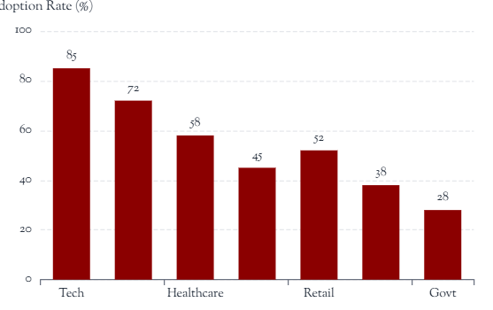
SECTION 1.1
The AI Adoption Landscape: Drivers and Barriers
Primary Drivers
Figure 1: AI Adoption Variation Across Sectors
1.1.1 Large-Scale Data Availability
Exponential growth in digital data enables training of sophisticated models across domains
1.1.2 Computational Power Improvements
GPU/TPU advancements and cloud infrastructure democratize AI development
1.1.3 Algorithmic Breakthroughs
Deep learning, transformer architectures, and reinforcement learning advances
Key Barriers
1.1.4 Data Privacy Concerns
GDPR, CCPA compliance requirements and consumer privacy expectations
Source: Industry analysis, 2026
1.1.5 Ethical Considerations
Bias, fairness, and societal impact concerns slowing deployment
1.1.6 Skills Shortage
Critical gap in AI/ML talent across technical and domain expertise
Key Insight: AI adoption is not uniform. While some organizations heavily invest in automation, others remain in experimentation phases, creating a widening competitive gap.

Slide 4

SECTION 2.1
Healthcare: AI-Powered Medical Innovation
2.1.1 Key AI Applications
Early Disease Detection
Predictive Analytics
Personalized Medicine
ML models identify patterns in imaging data for cancer, diabetic retinopathy
Risk stratification, readmission prediction, resource optimization
Genomic analysis, treatment recommendation, drug discovery
2.1.2 Critical Challenges
Bias in Datasets
Underrepresentation of minority populations leads to disparate diagnostic accuracy
Explainability Gap
Black-box models create trust issues; physicians require interpretable reasoning
Clinical Acceptance
Doctors hesitate to rely on AI without understanding decision pathways
Clinical Reality: Despite technological capabilities, the medical community demands transparency and validation before widespread adoption.
Figure 2: AI in clinical practice

Slide 5
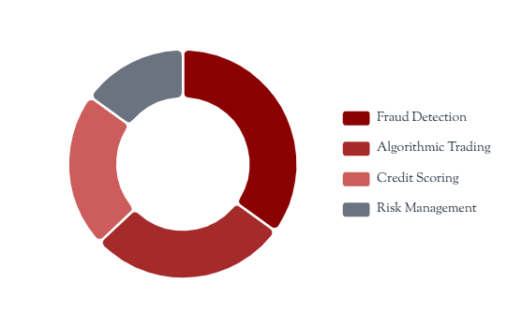
SECTION 3.1
Finance: Algorithmic Intelligence in Financial Services
3.1.1 AI Deployment Areas
Figure 3: Financial AI Impact Areas
01
Fraud Detection Systems
Real-time transaction monitoring, anomaly detection, pattern recognition for fraudulent activities
02
Algorithmic Trading
High-frequency trading, market sentiment analysis, predictive modeling for investment decisions
03
Credit Scoring
Alternative data integration, risk assessment, automated lending decisions
3.1.2 Transparency and Fairness Concerns
Source: Financial services analysis, 2026
Automated Decision Impact: AI-driven credit denials affect individuals' financial lives without human oversight
Algorithmic Bias: Historical data biases perpetuate discrimination in lending and insurance
Regulatory Challenges: Explainability requirements conflict with proprietary model protection
Critical Issue: When AI makes financial decisions affecting individuals, transparency and fairness become not just ethical imperatives but regulatory requirements.

Slide 6

SECTION 4.1
Education: Transforming Learning Through Intelligence
4.1.1 AI Applications in Education
Adaptive Learning
Automated Grading
Intelligent Tutoring
Personalized content delivery based on student performance and learning pace
Essay scoring, assessment automation, immediate feedback systems
AI-powered tutoring systems providing personalized guidance
4.1.2 Implementation Challenges
Infrastructure Gaps
Insufficient internet connectivity and device access in developing regions
Teacher Training Needs
Educators require professional development to effectively integrate AI tools
Pedagogical Balance
Maintaining human connection while leveraging technological advantages
Educational Imperative: Technology alone cannot transform education; teacher empowerment and equitable access are prerequisites for meaningful impact.
Figure 4: Digital learning environments

Slide 7
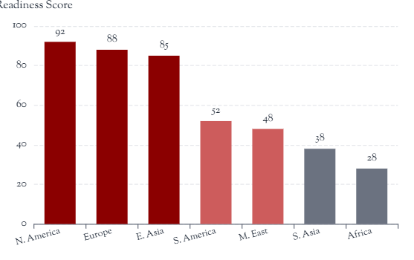
SECTION 5.1
The Digital Divide: Access and Infrastructure Challenges
5.1.1 Dimensions of Inequality
Figure 5: Global AI Readiness Index
Geographic Disparities
Developing regions face significant infrastructure deficits. Rural areas in Africa, South Asia, and Latin America lack reliable internet connectivity and computing resources necessary for AI deployment.
Socioeconomic Gaps
High costs of AI technologies, cloud computing services, and specialized hardware create barriers for underfunded institutions, small businesses, and economically disadvantaged communities.
Source: World Economic Forum, 2026
Educational Inequity
Schools in low-income areas cannot afford AI-powered educational tools, widening the achievement gap and limiting future economic opportunities for disadvantaged students.
5.1.2 Implications
The digital divide threatens to create a two-tiered world where AI benefits concentrate in wealthy nations and elite institutions, perpetuating global inequality and limiting human potential.

Slide 8

SECTION 6.1
Ethical AI: Principles for Responsible Innovation
6.1.1 Core Ethical Principles
Transparency
Fairness
Accountability
AI systems must be explainable and interpretable, with clear documentation of decision-making processes
Algorithms must avoid discrimination and ensure equitable outcomes across demographic groups
Clear responsibility chains for AI decisions, with mechanisms for redress and oversight
6.1.2 Global Regulatory Landscape
European Union: AI Act establishing risk-based regulatory framework
United States: Sector-specific guidelines and executive orders on AI governance
China: Algorithmic recommendation regulations and data governance laws
Global Challenge: No unified international standards create regulatory fragmentation
Organizational Responsibility: Companies must proactively implement ethical frameworks, conduct bias audits, and establish governance structures before regulatory mandates.
Figure 6: Ethical AI principles framework

Slide 9
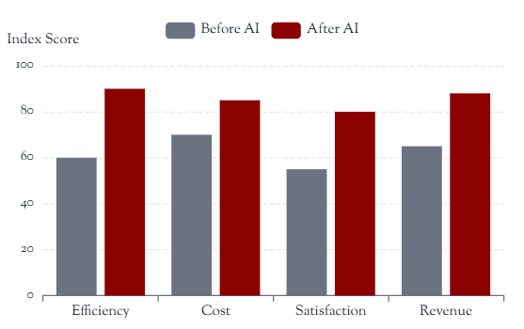
SECTION 7.1
Business Value: Efficiency, Cost Reduction, and Experience
Figure 7: Business Impact Metrics
7.1.1 Quantifiable Benefits
Operational Efficiency
35-50%
Reduction in processing time through automation of routine tasks and workflows
Cost Reduction
20-40%
Decreased operational costs through optimized resource allocation and reduced manual labor
Customer Experience
+45%
Source: Enterprise AI adoption survey, 2026
Improvement in satisfaction scores through personalized interactions and faster response times
7.1.3 Risk Management Requirements
7.1.2 Common AI Applications
Data Security: Protecting sensitive information from breaches and unauthorized access
System Reliability: Ensuring AI systems operate consistently and predictably
Chatbots
Recommendations
Predictive Analytics
24/7 customer support
Personalized suggestions
Demand forecasting
Compliance: Meeting regulatory requirements for AI deployment

Slide 10
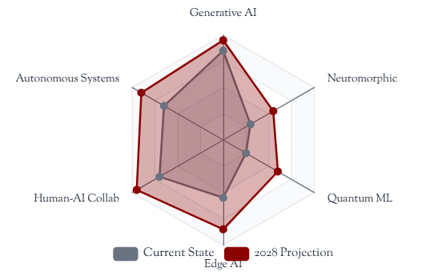
SECTION 8.1
The Future of AI: Emerging Technologies and Collaboration
8.1.1 Emerging Technology Frontiers
Figure 8: AI Technology Evolution Timeline
01
Generative AI
Large language models, image synthesis, and creative content generation transforming content production, design, and knowledge work
02
Autonomous Systems
Self-driving vehicles, robotic process automation, and autonomous decision-making systems reducing human intervention
03
Human-AI Collaboration
Augmented intelligence systems enhancing human capabilities rather than replacing them, enabling new forms of creative partnership
Source: Technology roadmap analysis, 2026
8.1.2 Balancing Innovation with Responsibility
Opportunity: Immense potential for solving complex global challenges in healthcare, climate, and education
Responsibility: Ensuring AI benefits society as a whole rather than creating further disparities
Strategic Imperative: Organizations must prepare for rapid technological evolution while maintaining ethical standards and societal responsibility.
Imperative: Proactive governance, inclusive development, and equitable distribution of AI benefits

Slide 11
SECTION 9.1
Conclusion: Navigating the Societal Transformation
9.1.1 Key Synthesis
Figure 9: Success Factor Framework
AI represents not merely a technological shift but a profound societal transformation that will reshape how we work, learn, receive healthcare, and interact with institutions. The success of this transformation depends on our collective ability to address fundamental challenges while harnessing AI's transformative potential.
Technological Innovation
30%
Ethical Governance
25%
Equitable Access
25%
Human Collaboration
20%
9.1.2 Critical Success Factors
Figure 9: Critical success factor weighting
Addressing Challenges
Ensuring Equitable Access
Proactively tackling bias, privacy, and security concerns
Bridging the digital divide for inclusive AI benefits
Maintaining Ethical Standards
Fostering Collaboration
Upholding transparency, fairness, and accountability
Human-AI partnership for collective benefit
"The measure of AI's success will not be its technical sophistication, but its contribution to human flourishing."
Fundamental Truth: Technology alone cannot create positive change. The path forward requires intentional design, inclusive development, and unwavering commitment to human welfare.

Slide 12
The Path Forward
AI's success depends on how well we address its challenges while leveraging its potential for the benefit of all.
Responsibility
Inclusion
Innovation
A Societal Transformation Requiring Collective Action

